Slide 1
MOSFET
The MOSFET (MOS Field-Effect Transistor) is the building block of Gb memory chips, GHz microprocessors, analog, and RF circuits.
Match the following MOSFET characteristics with their applications:
  small size
  high speed
  low power
  high gain

Slide 2
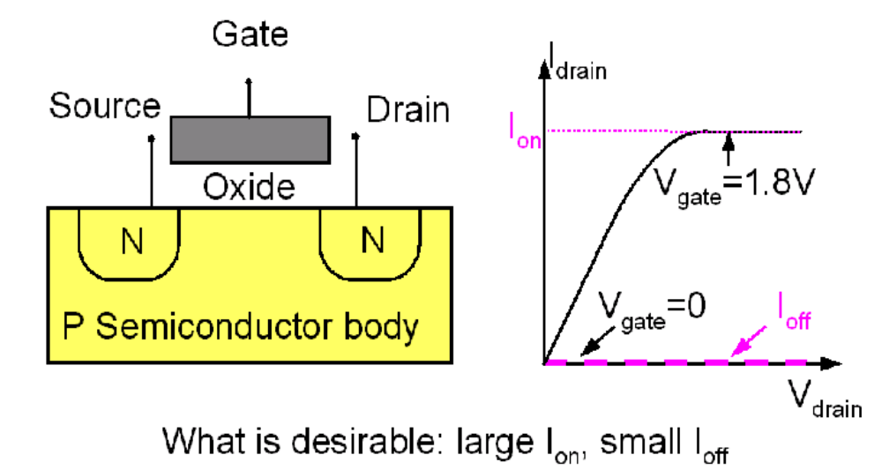
Introduction to the MOSFET
Basic MOSFET structure and IV characteristics
+
+

Slide 3
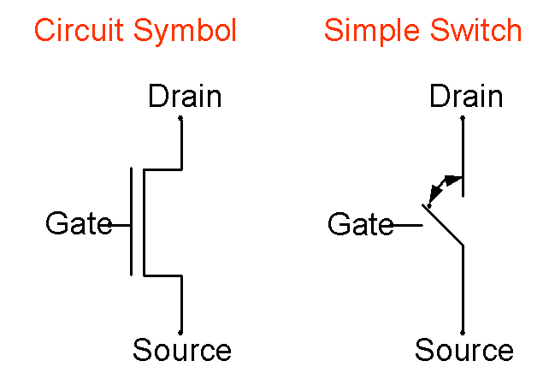
Introduction to the MOSFET
Two ways of representing a MOSFET:

Slide 4
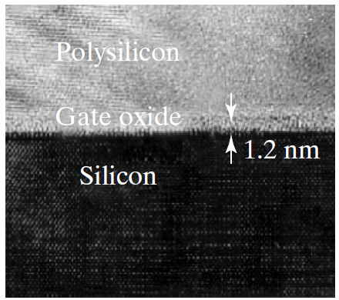
MOSFETs Technology
Polysilicon gate and 1.2nm SiO₂
1.2 nm SiO₂ used in production. Leakage current through the oxide limits further thickness reduction.

Slide 5
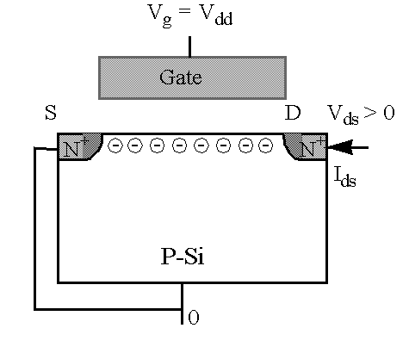
Surface Mobilities and High-Mobility FETs
Surface Mobilities
V_{g} = V_{dd} , V_{gs} = V_{dd}
V_{ds} > 0
I_{ds}
How to measure the surface mobility:
I
=
W
⋅
Q
⋅
v
=
WQ
μ
E
=
WQ
μ
V
/
L
ds
inv
inv
ns
inv
ns
ds
=
WC
(
V
−
V
)
μ
V
/
L
oxe
gs
t
ns
ds

Slide 6
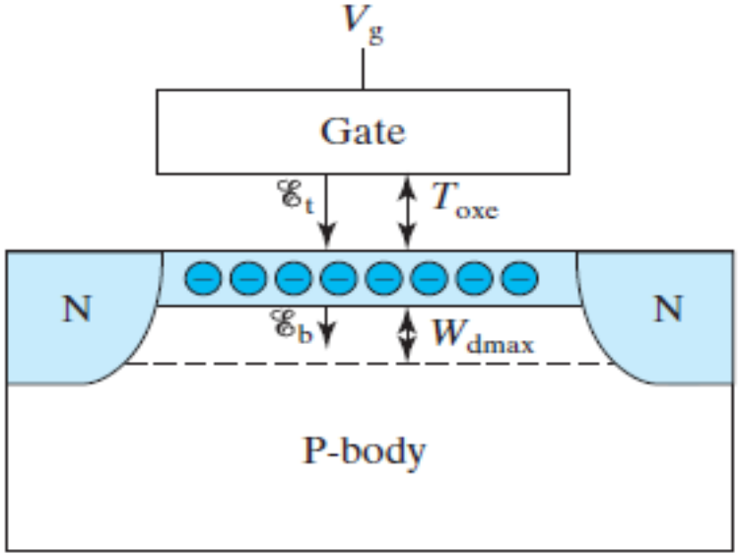

Mobility is a function of the average of the fields at the bottom and the top of the inversion charge layer, E_{b} and E_{t} .
From Gauss’s Law,
E_{b} = – Q_{dep}/ε_{s}
Therefore,
=
C
−
−
φ
E
oxe
(
V
V
)
b
ε
t
fb
st
s
∴
1
C
(
E
+
E
)
=
oxe
(
V
+
V
−
2
V
−
2
φ
)
E
=
−
(
Q
+
Q
)
/
ε
2
b
t
2
ε
gs
t
fb
st
t
dep
inv
s
s
C
≈
C
+
+
=
E
−
Q
/
ε
=
E
+
oxe
(
V
−
V
)
oxe
(
V
V
0
.
2
V
)
b
inv
s
b
ε
gs
t
2
ε
gs
t
s
s
C
V
+
V
+
0
.
2
V
=
oxe
(
V
−
V
−
φ
)
=
gs
t
ε
gs
fb
st
6
T
s
oxe

Slide 7
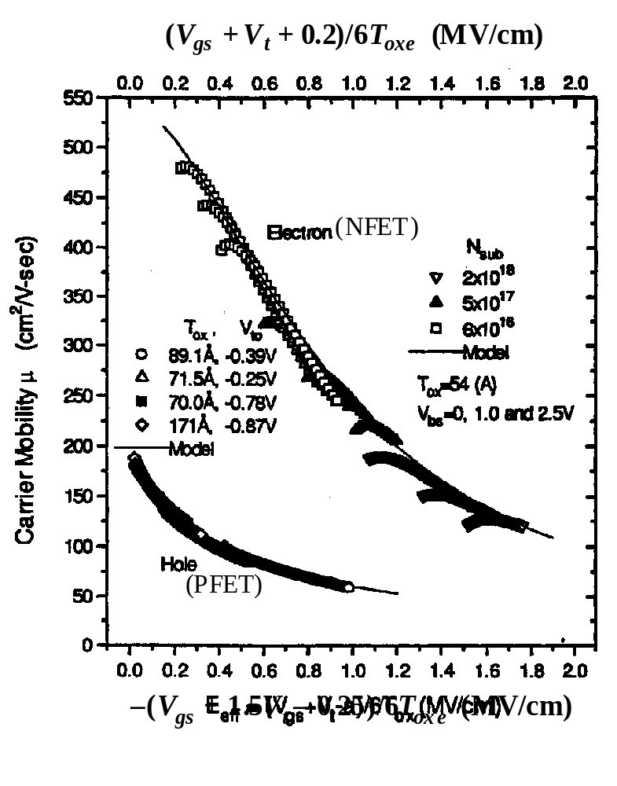
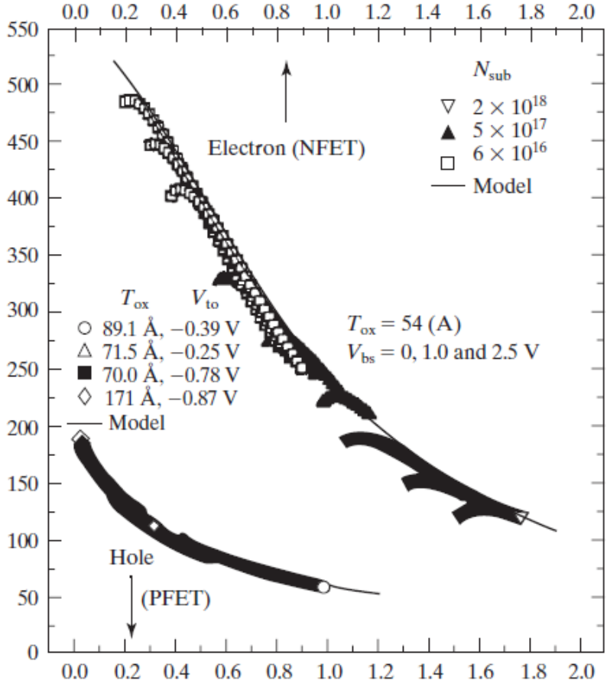
Universal Surface Mobilities
Surface roughness
scattering is stronger (mobility is lower) at higher V_{g}, higher V_{t}, and thinner T_{oxe}.
Surface mobility (cm²/V-s)

Slide 8
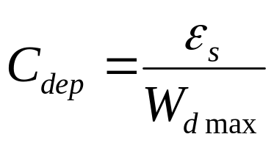
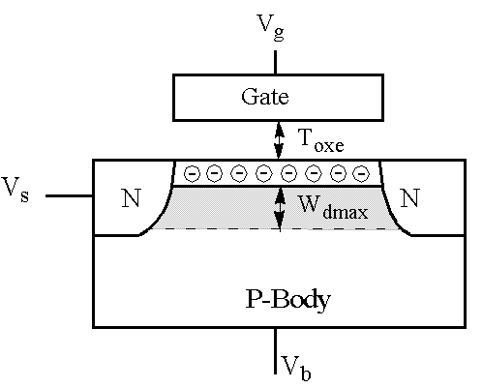
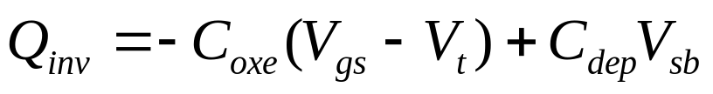
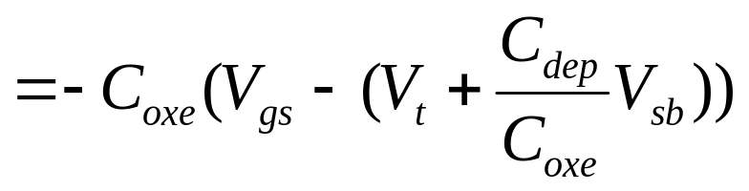
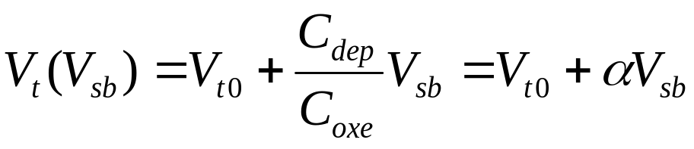
MOSFET V_{t} and the Body Effect
Two capacitors => two charge components
C_{oxe}
Redefine V_{t} as
C_{dep}

Slide 9
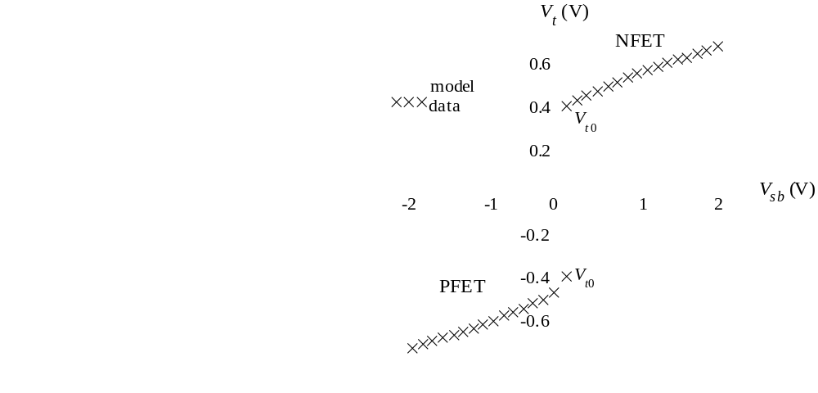
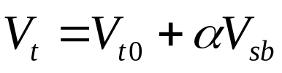
MOSFET V_{t} and the Body Effect
Body effect: V_{t} is a function of V_{sb}. When the source-body junction is reverse-biased, V_{t} increases.
Body effect coefficient:
α = C_{dep}/C_{oxe}
= 3T_{oxe} / W_{dep}
Body effect slows down circuits? How can it be reduced?

Slide 10
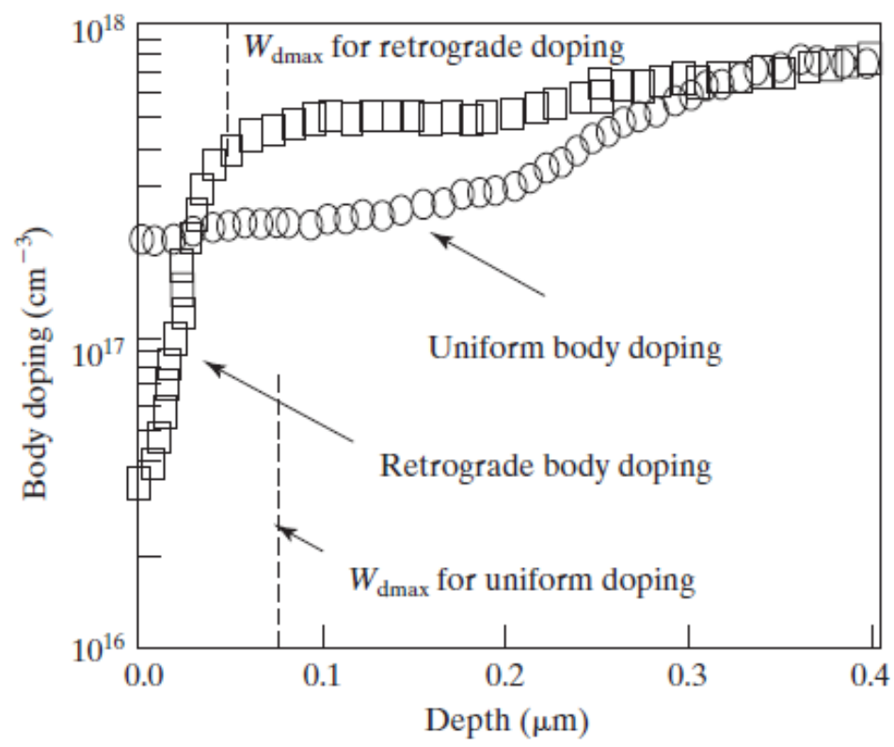
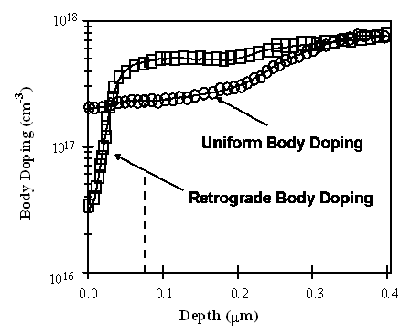
Retrograde Body Doping Profiles
W_{dmax} for retrograde doping
W_{dmax} for uniform doping
W_{dep} does not vary with V_{sb} .
Retrograde doping is popular because it reduces off-state
leakage and allows higher surface mobility.

Slide 11
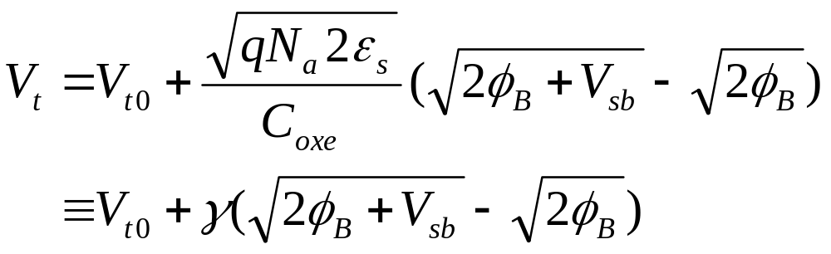
Uniform Body Doping
When the source/body junction is reverse-biased, there are two quasi-Fermi levels (E_{fn} and E_{fp}) which are separated by qV_{sb}. An NMOSFET reaches threshold of inversion when E_{c} is close to E_{fn} , not E_{fp} . This requires the band-bending to be 2φ_{B} + V_{sb} , not 2φ_{B}.
γ is the body-effect parameter.

Slide 12
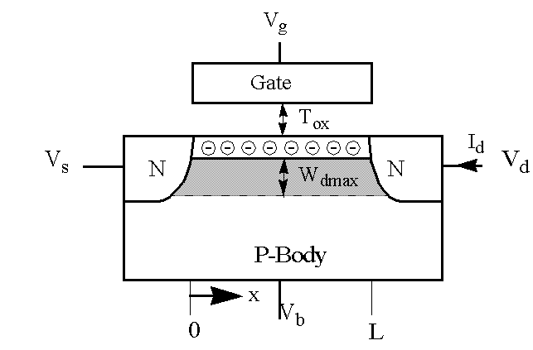
Q_{inv} in MOSFET
Channel voltage
V_{c}=V_{s} at x = 0 and
V_{c}=V_{d} at x = L.
Q_{inv} = – C_{oxe}(V_{gs} – V_{cs} – V_{t0} – α (V_{sb}+V_{cs})
= – C_{oxe}(V_{gs} – V_{cs} – (V_{t0} +α V_{sb}) – α V_{cs})
= – C_{oxe}(V_{gs} – mV_{cs} – V_{t})
m ≡ 1 +α = 1 + 3T_{oxe}/W_{dmax}
m is called the body-effect factor or bulk-charge factor

Slide 13
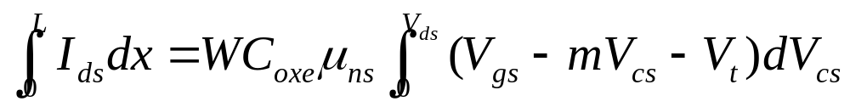
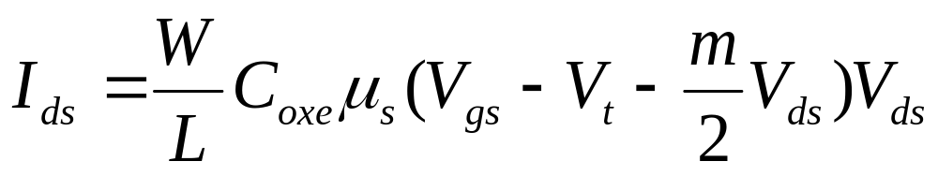
6.6 Basic MOSFET IV Model
I_{ds}= WQ_{inv}v= WQ_{inv}μ_{ns}E
= WC_{oxe}(V_{gs}– mV_{cs} – V_{t})μ_{ns}dV_{cs}/dx
I_{ds}L = WC_{oxe}μ_{ns}(V_{gs} – V_{t} – mV_{ds}/2)V_{ds}

Slide 14
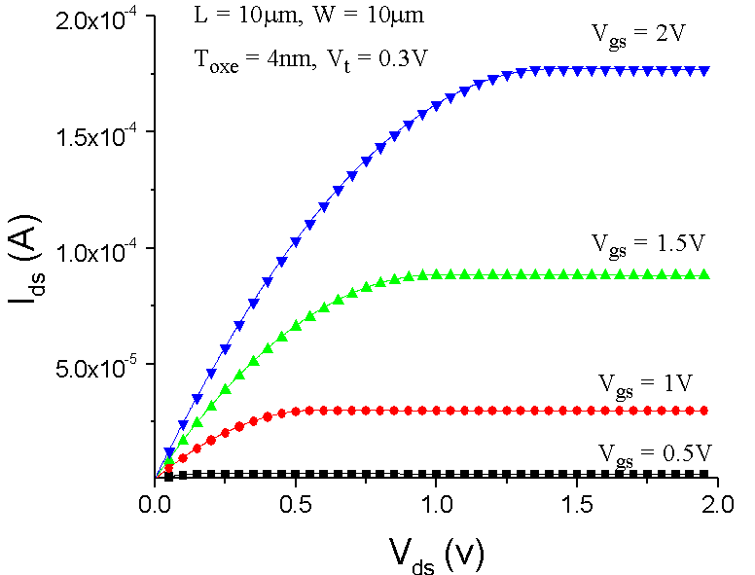
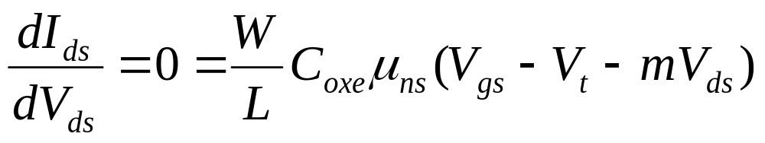
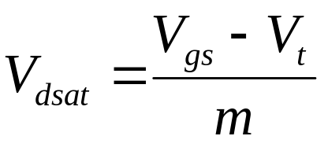
V_{dsat} : Drain Saturation Voltage

Slide 15
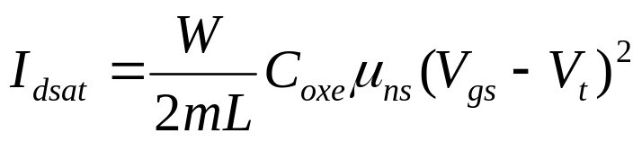
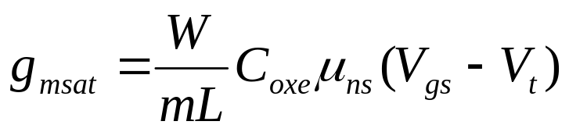
Saturation Current and Transconductance
linear region, saturation region
transconductance: g_{m}= dI_{ds}/dV_{gs}

Slide 16
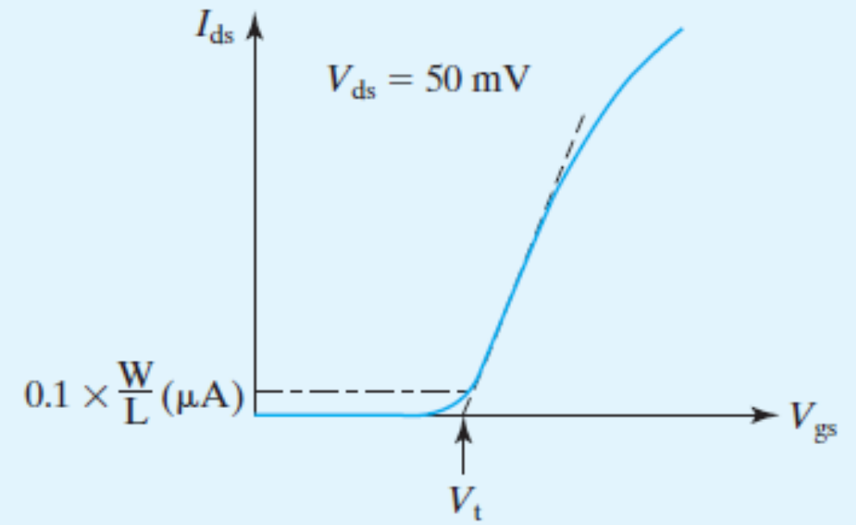
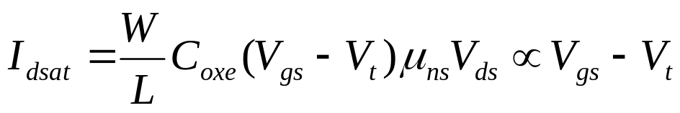

V_{t} and Body Effect
How to Measure the V_{t} of a MOSFET
A
B
Method A. V_{t} is measured by extrapolating the I_{ds} versus V_{gs} curve to I_{ds} = 0.
Method B. The Vg at which Ids =0.1μA W/L

Slide 17
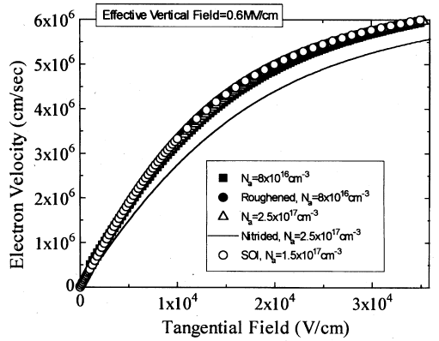
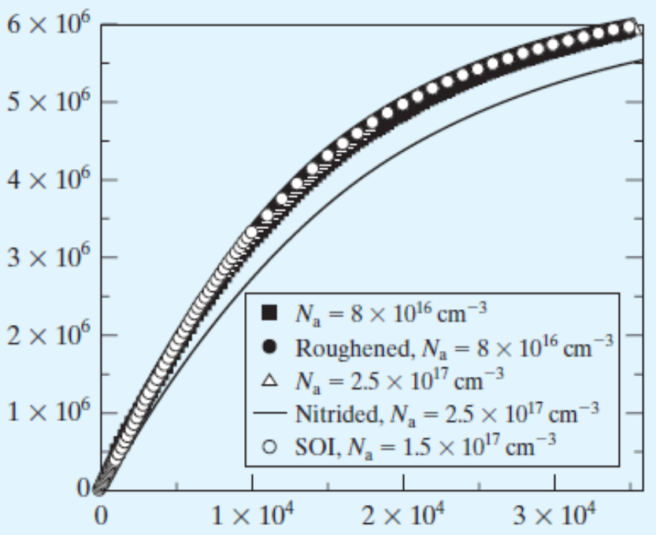
Velocity Saturation
μ
E
v
=
ns
E
1
+
E
sat
E << E_{sat} : v = μ E
ns
E >> E_{sat} : v = μ E_{sat}
ns
Velocity saturation has
large and deleterious
effect on the I_{on} of
MOSFETS

Slide 18
MOSFET IV Model with Velocity Saturation
I
=
WQ
v
ds
inv
μ
dV
/
dx
I
=
WC
(
V
−
mV
−
V
)
ns
cs
ds
oxe
gs
cs
t
dV
1
+
cs
/
E
dx
sat
L
V
∫
=
∫
μ
−
−
−
I
dx
ds
[
WC
(
V
mV
V
)
I
/
]
E
dV
0
ds
0
oxe
ns
gs
cs
t
ds
sat
cs
m
I
L
=
WC
μ
(
V
−
V
−
V
)
V
−
I
V
/
E
ds
oxe
ns
gs
t
2
ds
ds
ds
ds
sat

Slide 19
MOSFET IV Model with Velocity Saturation
W
m
C
μ
(
V
−
V
−
V
)
V
L
oxe
ns
gs
t
2
ds
ds
I
=
ds
V
1
+
ds
E
L
sat
long
-
channel
I
I
=
ds
ds
1
+
V
/
E
L
ds
sat

Slide 20
I_{dsat} with Velocity Saturation
Substituting V_{dsat} for V_{ds} in I_{ds} equation gives:
W
(
V
−
V
)
2
long
-
channel
I
I
=
C
μ
gs
t
=
dsat
dsat
2
mL
oxe
s
V
−
V
V
−
V
1
+
gs
t
1
+
gs
t
mE
L
mE
L
sat
sat
Very short channel case:
<<
−
E
L
V
V
sat
gs
t
I
=
Wv
C
(
V
−
V
−
mE
L
)
dsat
sat
oxe
gs
t
sat
I
=
Wv
C
(
V
−
V
)
dsat
sat
oxe
gs
t
I_{dsat} is proportional to V_{gs}–V_{t} rather than (V_{gs} – V_{t})² , not
as sensitive to L as 1/L.

Slide 21
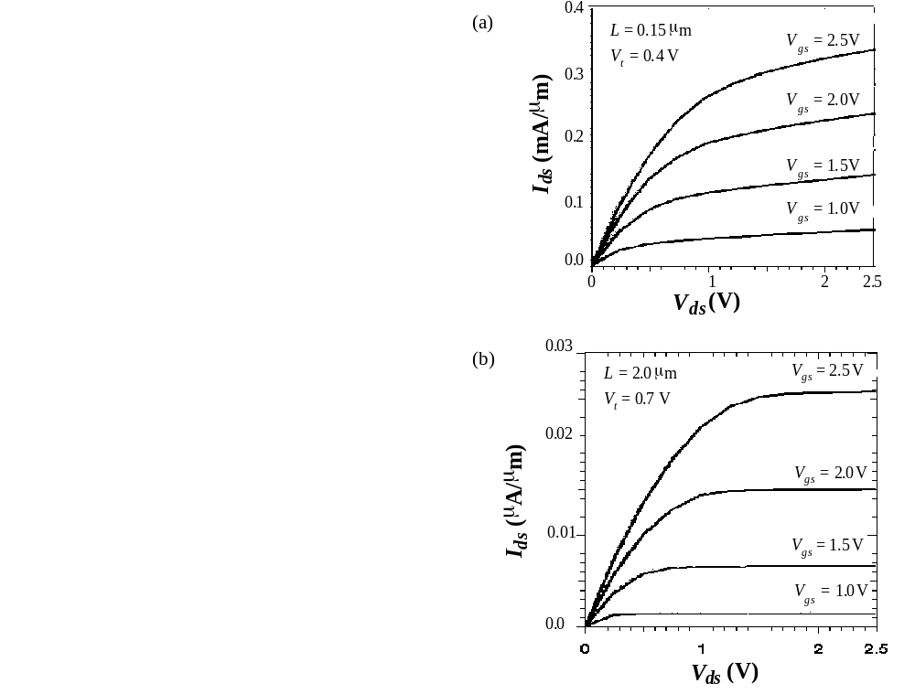
Measured MOSFET IV
What is the main difference between the V_{g} dependence of the long- and short-channel length IV curves?

Slide 22
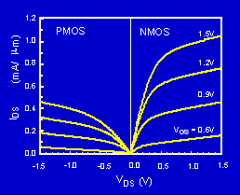
PMOS and NMOS IV Characteristics
The PMOS IV is qualitatively similar to the NMOS IV, but the current is about half as large. How can we design a CMOS inverter so that its voltage transfer curve is symmetric?

Slide 23
Velocity Saturation vs. Pinch-Off
Current saturation : the carrier velocity reaches V_{sat} at the drain.
Instead of the pinch-off region, there is a velocity saturation region next to the drain where Q_{inv} is a constant (I_{dsat}/W_{vsat}).

Slide 24
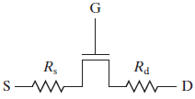
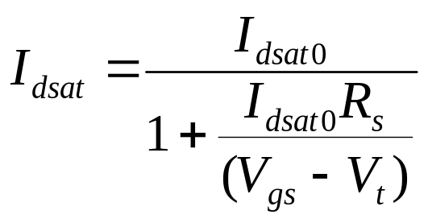
Parasitic Source-Drain Resistance
If I_{dsat0} ∝ V_{g} – V_{t} ,
I_{dsat} can be reduced by about 15% in a 0.1μm MOSFET. Effect is greater in shorter MOSFETs.
V_{dsat} = V_{dsat0} + I_{dsat} (R_{s} + R_{d})

Slide 25
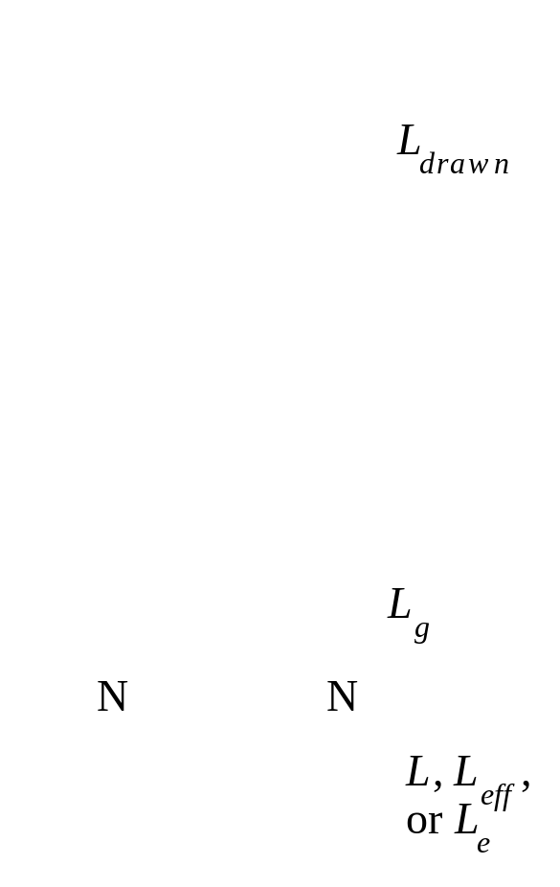
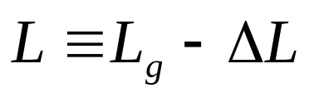
Definitions of Channel Length

Slide 26
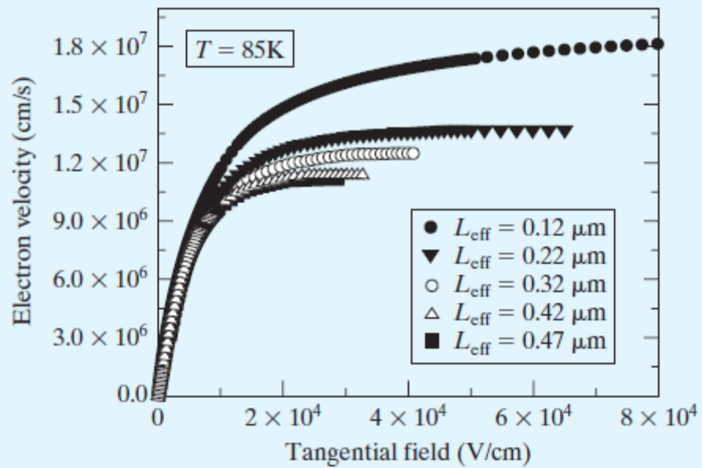
Velocity Overshoot
Velocity saturation should not occur in very short MOSFETs.
This velocity overshoot could lift the limit on Ids .
But…

Slide 27
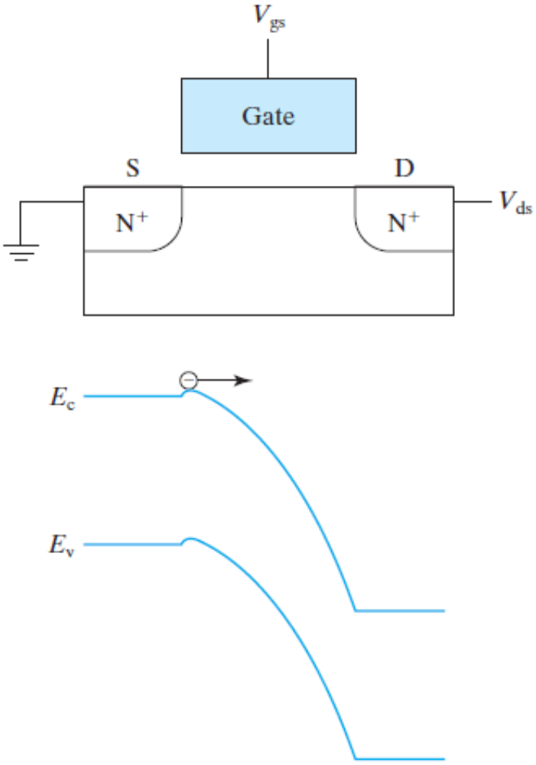
Source Velocity Limit
Carrier velocity is limited
by the thermal velocity
with which they enter the
channel from the source.
I_{dsat} = WBv_{thx}Q_{inv}
= WBv_{thx}C_{oxe}(V_{gs} – V_{t})
Similar to
I
=
Wv
C
(
V
−
V
)
dsat
sat
oxe
gs
t

Slide 28
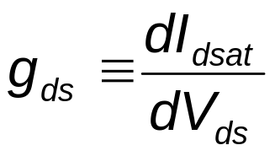
Output Conductance
I_{dsat} does NOT saturate in the saturation region, especially in short channel devices!
The slope of the I_{ds}-V_{ds} curve in the saturation region is called the output conductance (g_{ds}),
A smaller g_{ds} is desirable for a large voltage gain, which is beneficial to analog and digital circuit applications.

Slide 29
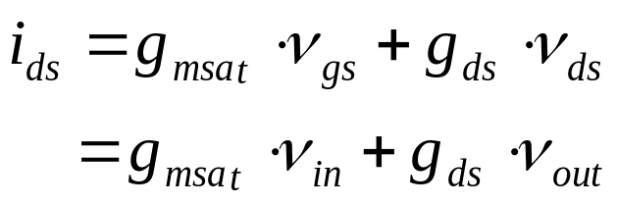

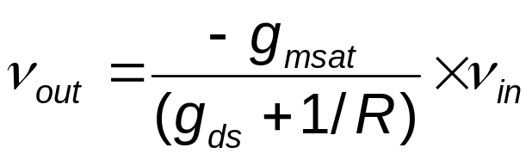
Example of an Amplifier
The transistor operates in the saturation region. A small signal input, v_{in}, is applied.
V_{dd}
R
ν_{out}
ν_{in}
NFET
The voltage gain is g_{msat}/(g_{ds} + 1/R).
A smaller g_{ds} is desirable for large voltage gain.
Maximum available gain (or intrinsic voltage gain) is g_{msat}/g_{ds}

